Slide 1
Potatoes? Tuberculosis? Cancer? not quite...
Tuberous sclerosis complex and the TSC2 gene
Rachel Yan

Slide 2
...so what is tuberous sclerosis complex (TSC)?

Slide 3
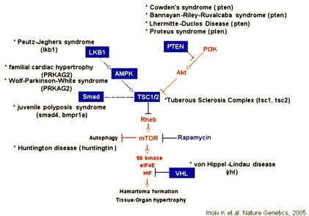
...so what is tuberous sclerosis complex (TSC)?

Slide 4
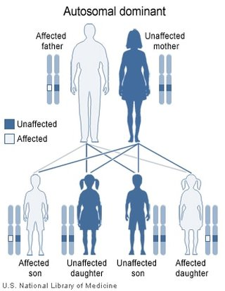
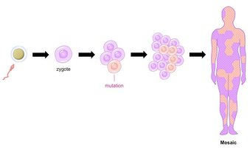
...so what is tuberous sclerosis complex (TSC)?

Slide 5
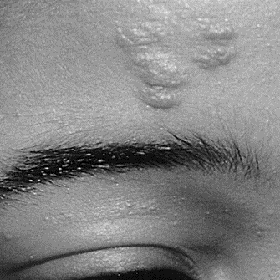
...so what is tuberous sclerosis complex (TSC)?

Slide 6
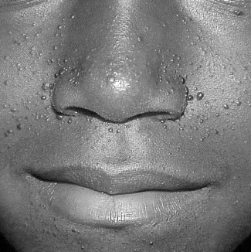
...so what is tuberous sclerosis complex (TSC)?

Slide 7
...so what is tuberous sclerosis complex (TSC)?

Slide 8
...so what is tuberous sclerosis complex (TSC)?

Slide 9
...so what is tuberous sclerosis complex (TSC)?

Slide 10
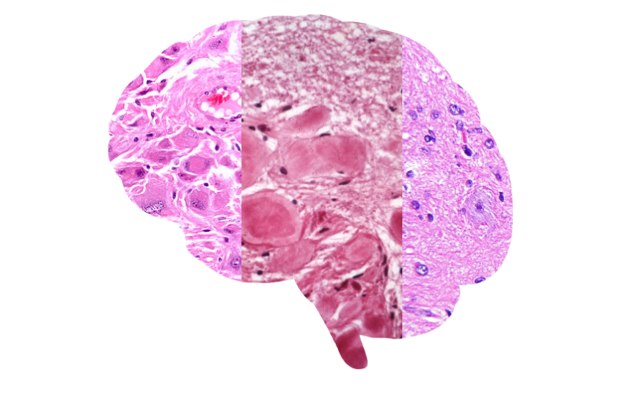
...so what is tuberous sclerosis complex (TSC)?
SEGA

Slide 11
...so what is tuberous sclerosis complex (TSC)?
SEGA SEN

Slide 12
...so what is tuberous sclerosis complex (TSC)?
SEGA SEN Cortical tuber

Slide 13
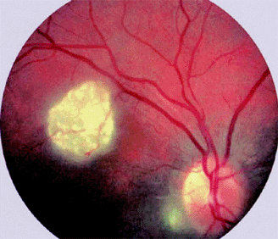
...so what is tuberous sclerosis complex (TSC)?
Retinal nodular hamaratoma
SEGA SEN Cortical tuber

Slide 14
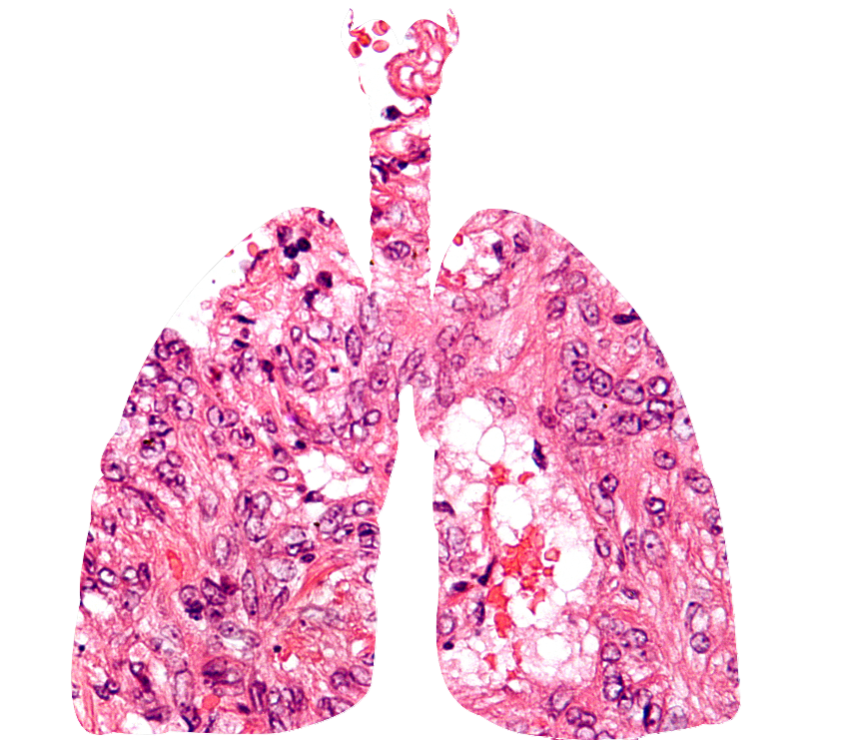
...so what is tuberous sclerosis complex (TSC)?

Slide 15
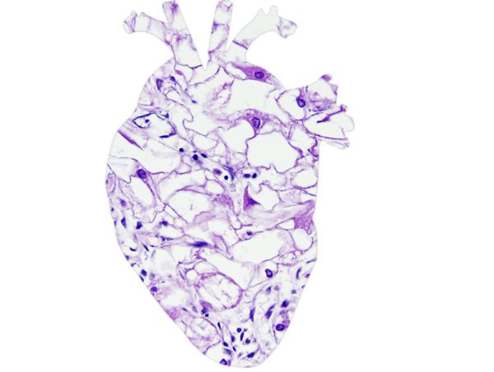
...so what is tuberous sclerosis complex (TSC)?

Slide 16
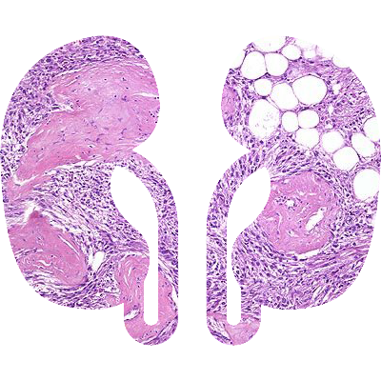
...so what is tuberous sclerosis complex (TSC)?

Slide 17
...so what is tuberous sclerosis complex (TSC)?
Definite: 2 or 1 + 2
Probable: 1 + 1
Possible: 1 or 0 + 2

Slide 18
TSC2 Gene chr16:2,095,990-2,140,713

Slide 19
TSC2 is well conserved
Human
DUF3384
tuberin
Rap-GAP
1807aa
Rat
DUF3384
tuberin
Rap-GAP
1809aa
Mouse
DUF3384
tuberin
Rap-GAP
1808aa
Zebrafish
DUF3384
tuberin
Rap-GAP
1818aa
Tropical
Frog
DUF3384
tuberin
Rap-GAP
1808aa
D. melanogaster
DUF3384
tuberin
Rap-GAP
1847aa
C. elegan
Rap-GAP
811aa
E. coli
79aa
Bonobo
DUF3384
tuberin
Rap-GAP
1807aa
Naked mole rat
DUF3384
tuberin
Rap-GAP
1810aa

Slide 20
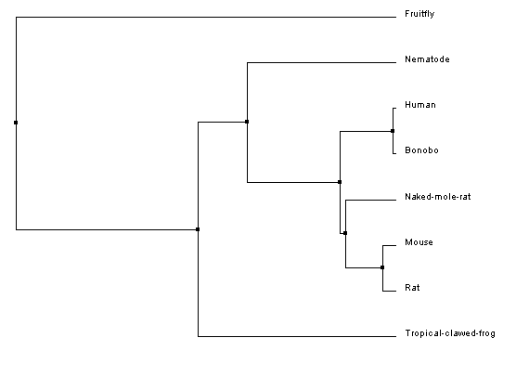
Phylogeny

Slide 21
Protein interactions

Slide 22
Gap in knowledge

Slide 23
Hypothesis

Slide 24
Aim 1

Slide 25
Aim 2

Slide 26
Aim 3

Slide 27
Future Directions

Slide 28
References
[1] Orlova, K. A., Crino, P. B. (2010). The tuberous sclerosis complex. Annals of the New York Academy of Sciences, 1184, 87–105. http://doi.org/10.1111/j.1749-6632.2009.05117.x [2] Davis, P. E., Peters, J. M., Krueger, D. A., & Sahin, M. (2015). Tuberous Sclerosis: A New Frontier in Targeted Treatment of Autism. Neurotherapeutics, 12(3), 572–583. http://doi.org/10.1007/s13311-015-0359-5 [3] Chu-Shore, C. J., Major, P., Camposano, S., Muzykewicz, D. and Thiele, E. A. (2010). The natural history of epilepsy in tuberous sclerosis complex. Epilepsia, 51, 1236–1241. http://doi.org/10.1111/j.1528-1167.2009.02474.x [4] Yang, P., Cornejo, K. M., Sadow, P. M., Cheng, L., Wang, M., Xiao, Y., … Wu, C.-L. (2014). Renal Cell Carcinoma in Tuberous Sclerosis Complex. The American Journal of Surgical Pathology, 38(7), 895–909. http://doi.org/10.1097/PAS.0000000000000237 [5] Inoki, K., Corradetti, M. N., Guan, K. (2005). Dysregulation of the TSC-mTOR pathway in human disease. Nature Genetics 37, 19-24. http://doi.org/10.1038/ng1494 [6] Roach, E.S., Gomez, Manuel, R., Northup, H. (1998). Tuberous Sclerosis Complex Consensus Conference: Revised Clinical Diagnostic Criteria. Journal of Child Neurology, 13(12) 624-628. http://doi.org/10.1177/088307389801301206 [7] Kwiatkowski, D. J., Palmer, M. R., Jozwiak, S., Bissler, J., et al. (2015). Response to everolimus is seen in TSC-associated SEGAs and angiomyolipomas independent of mutation type and site in TSC1 and TSC2. European Journal of Human Genetics 23, 1665–1672. http://doi.org/10.1038/ejhg.2015.47 [8] Qin, W., Kozlowski, P., Taillon, B.E. et al. (2010). Ultra deep sequencing detects a low rate of mosaic mutations in tuberous sclerosis complex. Human Genetics, 127(5), 573-582. http://doi.org/10.1007/s00439-010-0801-z [9] Tyburczy M. E., Dies K. A., Glass J., Camposano S., Chekaluk Y., et al. (2015) Mosaic and Intronic Mutations in TSC1/TSC2 Explain the Majority of TSC Patients with No Mutation Identified by Conventional Testing. PLOS Genetics 11(11): e1005637. http://doi.org/10.1371/journal.pgen.1005637 [10] Giannikou K., Malinowska I. A., Pugh T. J., Yan R., Tseng Y. Y., et al. (2016). Whole Exome Sequencing Identifies TSC1/TSC2 Biallelic Loss as the Primary and Sufficient Driver Event for Renal Angiomyolipoma Development. PLOS Genetics 12(8): e1006242. http://doi.org/0.1371/journal.pgen.1006242 [11] Crino, P. B., Aronica, E., Baltuch, G., & Nathanson, K. L. (2010). Biallelic TSC gene inactivation in tuberous sclerosis complex. Neurology, 74(21), 1716–1723. http://doi.org/10.1212/WNL.0b013e3181e04325 [12] Foulkes, W. D., & Real, F. X. (2013). Many mosaic mutations. Current Oncology, 20(2), 85–87. http://doi.org/10.3747/co.20.1449
[13] Tee AR, Manning BD, Roux PP, Cantley LC, Blenis J (2003) Tuberous sclerosis complex gene products, tuberin and hamartin, control mTOR signaling by acting as a GTPase-activating protein complex toward Rheb. Curr Biol 13(15), 1259–68. http://doi.org/10.1016/S0960-9822(03)00506-2.
[14] Giannikou K, Malinowska IA, Pugh TJ, Yan R, Tseng Y-Y, Oh C, et al. (2016) Whole Exome Sequencing Identifies TSC1/TSC2 Biallelic Loss as the Primary and Sufficient Driver Event for Renal Angiomyolipoma Development. PLoS Genet 12(8): e1006242. http://doi.org/10.1371/journal.pgen.1006242 [15 Tyburczy ME, Dies KA, Glass J, Camposano S, Chekaluk Y, Thorner AR, et al. (2015) Mosaic and Intronic Mutations in TSC1/TSC2 Explain the Majority of TSC Patients with No Mutation Identified by Conventional Testing. PLoS Genet 11(11): e1005637. http://doi.org/10.1371/journal.pgen.1005637

Slide 29
Image References
Video References
​Novartis, https://www.youtube.com/watch?v=0WOAv3O_Vb8&t=25s
Image References
Header/Footer: https://www.cultivariable.com/buyers-guide-for-andean-roots-and-tubers/
Dr. House: http://www.housemd-guide.com/timeline-ep.php
Mosaic: https://www.pinterest.com/pin/292100725800999804/
Fig 1:http://www.daviddarling.info/images/autosomal_dominant.jpg
Fig 2: http://ib.bioninja.com.au/standard-level/topic-3-genetics/34-inheritance/mosaicism.html
Fig 3: https://en.wikipedia.org/wiki/Everolimus
Forehead plaque: http://www.medicinenet.com/image-collection/tuberous_sclerosis_fibrous_plaque_picture/picture.htm
Fig 4: http://www.lsi.umich.edu/inoki-lab/inoki-lab-research, [12]
FacialAngiofibroma: http://www.wikidoc.org/index.php/Tuberous_sclerosis_physical_examination
Retinal Nodular hamartoma: http://flylib.com/books/en/3.283.1.13/1/
Cortical tuber: http://frontalcortex.com/?page=oll&topic=24&qid=479
SEN: http://neuropathology-web.org/chapter7/chapter7aTumorsgeneral.html
SEGA: ​http://www.webpathology.com/image.asp?case=742&n=2
​Cardiac Rhabdomyoma: ​http://neuropathology-web.org/chapter7/images7/7-ts-heartmicro.jpg
Hypomelanotic macules:
Shagreen patch:
LAM: https://upload.wikimedia.org/wikipedia/commons/4/44/Lymphangioleiomyomatosis_-_very_high_mag.jpg
Cardiac rhabdomyoma:
​Renal angiomyolipoma: http://www.webpathology.com/image.asp?case=71&n=5
Nontraumatic ungual/periungual fibroma: ​

Slide 30
Thank you

