Slide 1
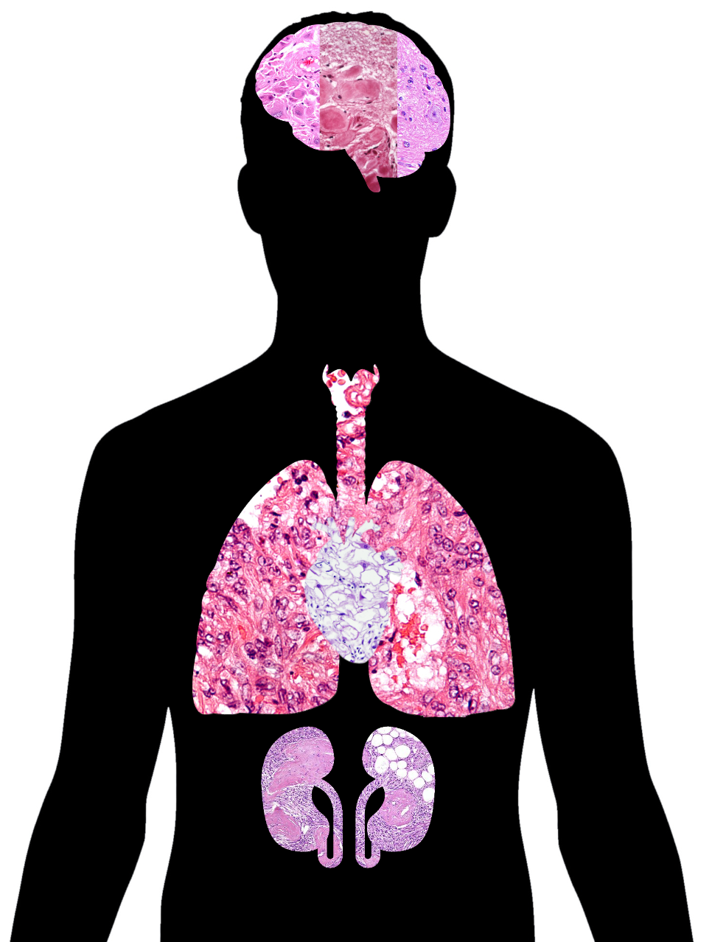
Tuberous sclerosis complex and TSC2
Rachel Yan

Slide 2
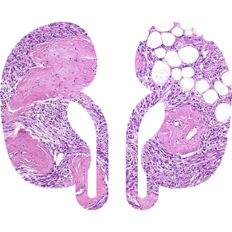
What is tuberculosis sclerosis complex?

Slide 3
How does tuberous sclerosis manifest?
1/6000

Slide 4
What gene is responsible for tuberous sclerosis?
TSC2
DUF3384
tuberin
Rap-GAP
1807aa

Slide 5
What processes are TSC2 involved in?
TSC2
DUF3384
tuberin
Rap-GAP
1807aa
Molecular function
Biological Process
Cellular Component
Protein binding
GTPase activator
Nitrogen compound metabolic process
Cell cycle arrest
Membrane
Phosphatase binding
Nucleus
Cytoplasm

Slide 6
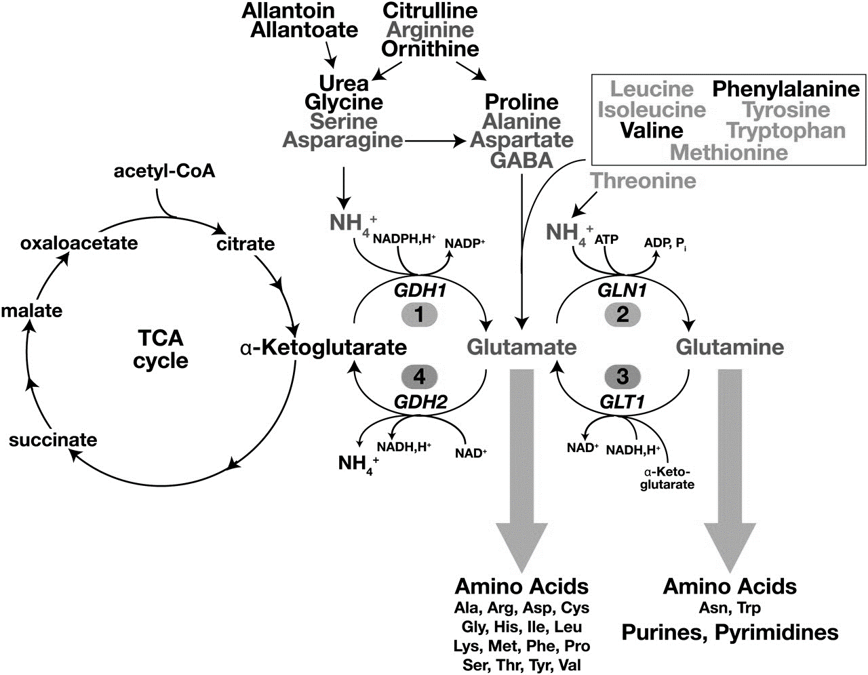
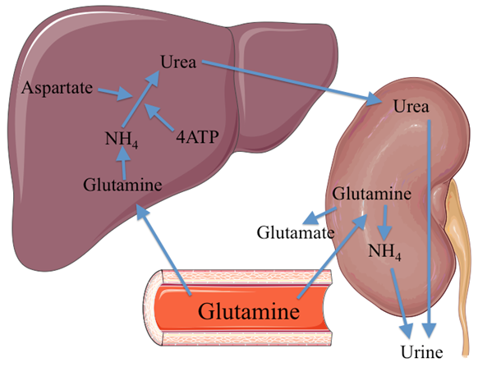
Gap: Does TSC2 have a role in nitrogen metabolism in the kidney?

Slide 7
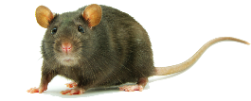
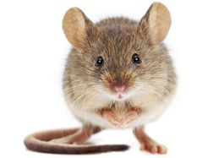
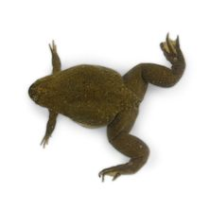
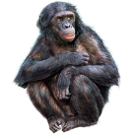
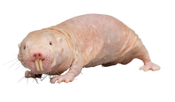
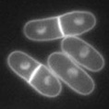
How well-conserved is TSC2 across species?
DUF3384
tuberin
Rap-GAP
1807aa
1809aa
1808aa
1818aa
1808aa
1847aa
811aa
1807aa
1810aa
1339aa

Slide 8
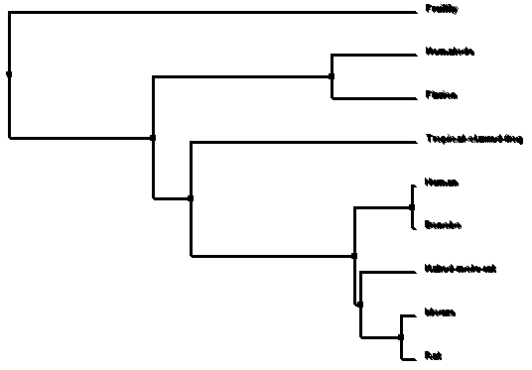
How are TSC2 homologs related?

Slide 9
How do we assay for nitrogen metabolism?
Schizosaccharomyces pombe

Slide 10
What is the mutant phenotype?
Schizosaccharomyces pombe
Leu

Slide 11
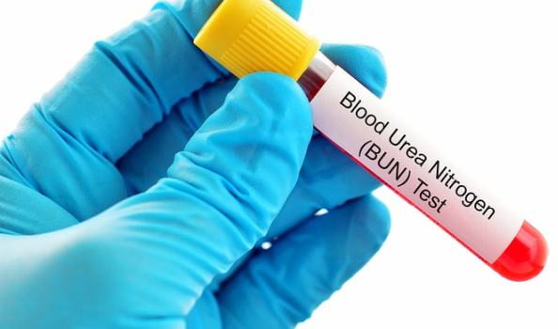
How do we assay for nitrogen metabolism in the kidney?
Rattus norvegicus
Blood Urea Nitrogen
15.6 mg/dcc

Slide 12
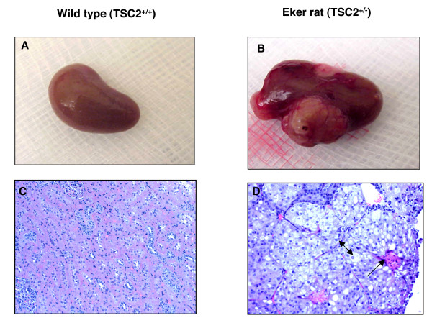
What is the mutant phenotype in the kidney?
Rattus norvegicus
Blood Urea Nitrogen
15.6 mg/dcc

Slide 13
Hypothesis: TSC2 has a role in nitrogen metabolism in the kidney
Gap: The role of TSC2 in nitrogen metabolism in the kidney is unknown
TSC2
DUF3384
tuberin
Rap-GAP
1807aa

Slide 14
My long-term goal is to determine if a BUN test may be useful in early detection of renal tumors
1807aa

Slide 15
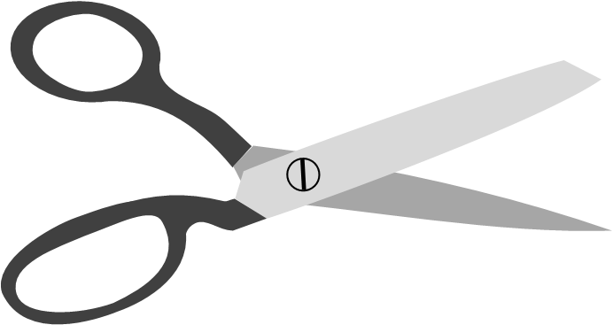
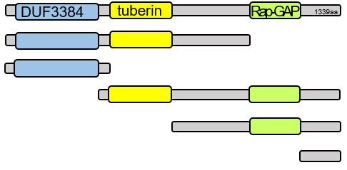
Primary goal: What is the function of TSC2 in nitrogen metabolism in the kidney?
Domain Analysis
RNA-seq
Yeast Two Hybrid
TSC2
DUF3384
tuberin
Rap-GAP
1807aa
DUF3384
WT ΔDUF3384
Aim 1
Aim 2
Aim 3

Slide 16
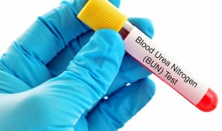
Aim 1: What domains in TSC2 are important for nitrogen metabolism?
?
DUF3384
tuberin
Rap-GAP
1807aa
Hypothesis: DUF3384 plays a role in nitrogen metabolism in the kidney
Rationale: DUF3384 is of unknown function and may confirm the role of TSC2 in nitrogen metabolism
DUF3384
CRISPR/Cas9
Nitrogen Depletion
CRISPR/Cas9
BUN/Histology
DUF3384

Slide 17
Aim 1: What domains in TSC2 are important for nitrogen metabolism?
?
DUF3384
tuberin
Rap-GAP
1807aa
CRISPR
DUF3384
tuberin
Rap-GAP
1339aa

Slide 18
Aim 1: What domains in TSC2 are important for nitrogen metabolism?
?
DUF3384
tuberin
Rap-GAP
1807aa
CRISPR
DUF3384
tuberin
Rap-GAP
1339aa

Slide 19
Aim 1: What domains in TSC2 are important for nitrogen metabolism?
?
DUF3384
tuberin
Rap-GAP
1807aa
CRISPR
DUF3384
tuberin
Rap-GAP
1339aa

Slide 20
Aim 1: What domains in TSC2 are important for nitrogen metabolism?
?
DUF3384
tuberin
Rap-GAP
1807aa
CRISPR
DUF3384
tuberin
Rap-GAP
P
1339aa
F
F
P
F
F

Slide 21
Aim 1: What domains in TSC2 are important for nitrogen metabolism?
?
DUF3384
tuberin
Rap-GAP
1807aa
CRISPR
DUF3384
tuberin
Rap-GAP
P
1339aa
F
F
P
F
F
DUF3384
Hypothesis: DUF3384 plays a role in nitrogen metabolism in the kidney

Slide 22
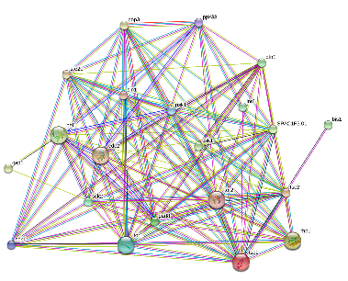
Aim 2: Are there different transcript levels of nitrogen in DUF3384 knockouts?
DUF3384
?
DUF3384
tuberin
Rap-GAP
1807aa
Hypothesis: DUF3384 regulates nitrogen metabolism by regulating gene expression responsible for response to nutrient levels and amino acid transmembrane transport
Rationale: Identifying differences in transcript levels will demonstrate the role TSC2 in gene regulation of nitrogen metabolism
DUF3384
RNA-Seq
Gene Ontology
CRISPR/Cas9
Screen
Notes:
Make yeast overall then cut domains off and use +++ to see if
Test if they grow on leucine deficient
Rat domains
http://www.scielo.br/img/revistas/gmb/2017nahead//1415-4757-gmb-1678-4685-GMB-2015-0321-gf01.jpg
Rationale: Patients with no mutation identified may have intronic variants that affect TSC2 transcription.
Hypothesis: I hypothesize that mutations in conserved regions will identify important intronic sequences for TSC2 transcription.
Always connect back to overall goal

Slide 23
Aim 2: Are there different transcript levels of nitrogen in DUF3384 knockouts?
DUF3384
Regulation of response to nutrient levels: tor2, sck2
Cell cycle arrest in response to nitrogen starvation: tor2
Regulation of amino acid transmembrane transport: tsc1
Regulation of L-arginine import: rhb1
WT
ΔDUF3384

Slide 24
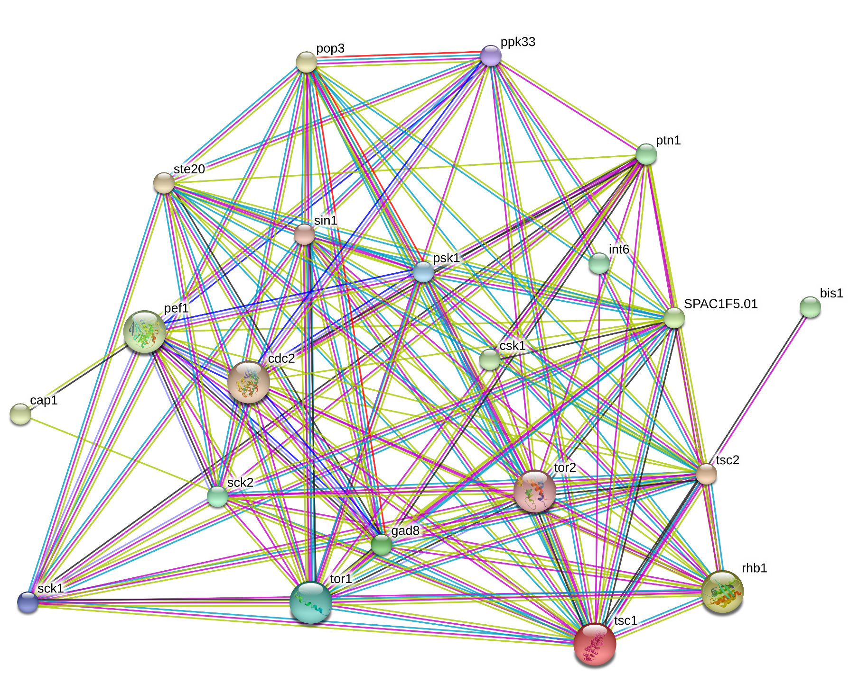
Aim 2: Are there different transcript levels of nitrogen in DUF3384 knockouts?
DUF3384
DF3384
Cellular protein metabolic process
Regulation of amino acid transmembrane transport
Regulation of response to nutrient levels
Regulation of L-arginine import
Cell cycle arrest in response to nitrogen starvation

Slide 25
Aim 2: Are there different transcript levels of nitrogen in DUF3384 knockouts?
DUF3384
DUF3384
tuberin
Rap-GAP
1807aa
CRISPR
Regulation of response to nutrient levels: tor2, sck2
Cell cycle arrest in response to nitrogen starvation: tor2
Regulation of amino acid transmembrane transport: tsc1
Regulation of L-arginine import: rhb1

Slide 26
Aim 2: Are there different transcript levels of nitrogen in DUF3384 knockouts?
DUF3384
DUF3384
tuberin
Rap-GAP
1807aa
CRISPR
Regulation of response to nutrient levels: tor2, sck2
Cell cycle arrest in response to nitrogen starvation: tor2
Regulation of amino acid transmembrane transport: tsc1
Regulation of L-arginine import: rhb1

Slide 27
Aim 2: Are there different transcript levels of nitrogen in DUF3384 knockouts?
DUF3384
DUF3384
tuberin
Rap-GAP
1807aa
CRISPR
Regulation of response to nutrient levels: tor2, sck2
F
Cell cycle arrest in response to nitrogen starvation: tor2
F
Regulation of amino acid transmembrane transport: tsc1
F
Regulation of L-arginine import: rhb1
F

Slide 28
Aim 2: Are there different transcript levels of nitrogen in DUF3384 knockouts?
DUF3384
DUF3384
tuberin
Rap-GAP
1807aa
CRISPR
Regulation of response to nutrient levels: tor2, sck2
F
Cell cycle arrest in response to nitrogen starvation: tor2
F
Regulation of amino acid transmembrane transport: tsc1
F
Regulation of L-arginine import: rhb1
F
Hypothesis: DUF3384 regulates nitrogen metabolism by regulating gene expression responsible for amino acid transport
DUF3384

Slide 29
Aim 3: What proteins interact with TSC2 DUF3384 in nitrogen metabolism in the kidney?
DUF3384
?
DUF3384
tuberin
Rap-GAP
1807aa
Hypothesis: DUF3384 interacts with other proteins that act in nitrogen metabolism in the kidney
Rationale: Identifying interacting proteins may elucidate the specific role of TSC2 in nitrogen metabolism in the kidney
DUF3384
Yeast 2H
Gene Ontology
CRISPR/Cas9
Screen

Slide 30
Aim 3: What proteins interact with TSC2 DUF3384 in nitrogen metabolism in the kidney?
DUF3384
 | TSC2 DUF3384 | Tor2 | Sck2 | Rhb1
TSC2 DUF3384
Tor2
Sck2
Rhb1
GO Groups
Regulation of response to nutrient levels: tor2, sck2
Cell cycle arrest in response to nitrogen starvation: tor2
Regulation of L-arginine import: rhb1

Slide 31
Aim 3: What proteins interact with TSC2 DUF3384 in nitrogen metabolism in the kidney?
DUF3384
 | TSC2 DUF3384 | Tor2 | Sck2 | Rhb1
TSC2 DUF3384
Tor2
Sck2
Rhb1
Regulation of response to nutrient levels: tor2, sck2
Cell cycle arrest in response to nitrogen starvation: tor2
 | TSC2 DUF3384 | Tor2 | Sck2 | Rhb1
TSC2 DUF3384
Tor2
Sck2
Rhb1

Slide 32
Aim 3: What proteins interact with TSC2 DUF3384 in nitrogen metabolism in the kidney?
DUF3384
Regulation of L-arginine import
Cell cycle arrest in response to nitrogen starvation
Regulation of response to nutrient levels

Slide 33
Aim 3: What proteins interact with TSC2 DUF3384 in nitrogen metabolism in the kidney?
Aim 3: What proteins interact with TSC2 DUF3384 in nitrogen metabolism in the kidney?
DUF3384
DUF3384
?
DUF3384
tuberin
Rap-GAP
1807aa
CRISPR
Regulation of response to nutrient levels: tor2, sck2
Cell cycle arrest in response to nitrogen starvation: tor2
Regulation of amino acid transmembrane transport: tsc1
Regulation of L-arginine import: rhb1
Notes:
http://www.domyownpestcontrol.com/images/content/rat.jpg
http://www.ratfanclub.org/tumors_files/image006.jpg

Slide 34
Aim 3: What proteins interact with TSC2 DUF3384 in nitrogen metabolism in the kidney?
Aim 3: What proteins interact with TSC2 DUF3384 in nitrogen metabolism in the kidney?
DUF3384
DUF3384
?
DUF3384
tuberin
Rap-GAP
1807aa
CRISPR
Regulation of response to nutrient levels: tor2, sck2
Cell cycle arrest in response to nitrogen starvation: tor2
Regulation of amino acid transmembrane transport: tsc1
Regulation of L-arginine import: rhb1
Notes:
http://www.domyownpestcontrol.com/images/content/rat.jpg
http://www.ratfanclub.org/tumors_files/image006.jpg

Slide 35
Aim 3: What proteins interact with TSC2 DUF3384 in nitrogen metabolism in the kidney?
Aim 3: What proteins interact with TSC2 DUF3384 in nitrogen metabolism in the kidney?
DUF3384
DUF3384
?
DUF3384
tuberin
Rap-GAP
1807aa
CRISPR
Regulation of response to nutrient levels: tor2, sck2
Cell cycle arrest in response to nitrogen starvation: tor2
Regulation of amino acid transmembrane transport: tsc1
Regulation of L-arginine import: rhb1
Notes:
http://www.domyownpestcontrol.com/images/content/rat.jpg
http://www.ratfanclub.org/tumors_files/image006.jpg

Slide 36
Aim 3: What proteins interact with TSC2 DUF3384 in nitrogen metabolism in the kidney?
Aim 3: What proteins interact with TSC2 DUF3384 in nitrogen metabolism in the kidney?
DUF3384
DUF3384
?
DUF3384
tuberin
Rap-GAP
1807aa
CRISPR
Regulation of response to nutrient levels: tor2, sck2
F
Cell cycle arrest in response to nitrogen starvation: tor2
F
Regulation of amino acid transmembrane transport: tsc1
F
Regulation of L-arginine import: rhb1
F
Notes:
http://www.domyownpestcontrol.com/images/content/rat.jpg
http://www.ratfanclub.org/tumors_files/image006.jpg

Slide 37
Aim 3: What proteins interact with TSC2 DUF3384 in nitrogen metabolism in the kidney?
Aim 3: What proteins interact with TSC2 DUF3384 in nitrogen metabolism in the kidney?
DUF3384
DUF3384
?
DUF3384
tuberin
Rap-GAP
1807aa
CRISPR
Regulation of response to nutrient levels: tor2, sck2
F
Cell cycle arrest in response to nitrogen starvation: tor2
F
Regulation of amino acid transmembrane transport: tsc1
F
Regulation of L-arginine import: rhb1
F
Hypothesis: DUF3384 interacts with other proteins that act in nitrogen metabolism in the kidney
DUF3384
Notes:
http://www.domyownpestcontrol.com/images/content/rat.jpg
http://www.ratfanclub.org/tumors_files/image006.jpg

Slide 38
Conclusions & Expected Findings
Domain Analysis
RNA-seq
Yeast Two Hybrid
TSC2
DUF3384
tuberin
Rap-GAP
1807aa
DUF3384
WT ΔDUF3384
Aim 1
Aim 2
Aim 3
DUF3384
TSC2 DUF3384 has a role in nitrogen metabolism in the kidney
It affects transcript levels and proteins involving cell cycle arrest in response to nitrogen deprivation and amino acid transport
A BUN test can be used for early detection of TSC-associated kidney tumors

Slide 39
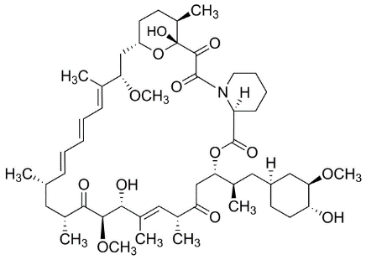
Where do we go from here?
Notes:
At what point in tumor development does a BUN test show results?
Is this applicable to humans?
Is this the reason that cancerous RCC develops in TSC patients?

Slide 40
References
[1] Orlova, K. A., Crino, P. B. (2010). The tuberous sclerosis complex. Annals of the New York Academy of Sciences, 1184, 87–105. http://doi.org/10.1111/j.1749-6632.2009.05117.x [2] Davis, P. E., Peters, J. M., Krueger, D. A., & Sahin, M. (2015). Tuberous Sclerosis: A New Frontier in Targeted Treatment of Autism. Neurotherapeutics, 12(3), 572–583. http://doi.org/10.1007/s13311-015-0359-5 [3] Chu-Shore, C. J., Major, P., Camposano, S., Muzykewicz, D. and Thiele, E. A. (2010). The natural history of epilepsy in tuberous sclerosis complex. Epilepsia, 51, 1236–1241. http://doi.org/10.1111/j.1528-1167.2009.02474.x [4] Yang, P., Cornejo, K. M., Sadow, P. M., Cheng, L., Wang, M., Xiao, Y., … Wu, C.-L. (2014). Renal Cell Carcinoma in Tuberous Sclerosis Complex. The American Journal of Surgical Pathology, 38(7), 895–909. http://doi.org/10.1097/PAS.0000000000000237 [5] Inoki, K., Corradetti, M. N., Guan, K. (2005). Dysregulation of the TSC-mTOR pathway in human disease. Nature Genetics 37, 19-24. http://doi.org/10.1038/ng1494 [6] Roach, E.S., Gomez, Manuel, R., Northup, H. (1998). Tuberous Sclerosis Complex Consensus Conference: Revised Clinical Diagnostic Criteria. Journal of Child Neurology, 13(12) 624-628. http://doi.org/10.1177/088307389801301206 [7] Kwiatkowski, D. J., Palmer, M. R., Jozwiak, S., Bissler, J., et al. (2015). Response to everolimus is seen in TSC-associated SEGAs and angiomyolipomas independent of mutation type and site in TSC1 and TSC2. European Journal of Human Genetics 23, 1665–1672. http://doi.org/10.1038/ejhg.2015.47 [8] Qin, W., Kozlowski, P., Taillon, B.E. et al. (2010). Ultra deep sequencing detects a low rate of mosaic mutations in tuberous sclerosis complex. Human Genetics, 127(5), 573-582. http://doi.org/10.1007/s00439-010-0801-z [9] Tyburczy M. E., Dies K. A., Glass J., Camposano S., Chekaluk Y., et al. (2015) Mosaic and Intronic Mutations in TSC1/TSC2 Explain the Majority of TSC Patients with No Mutation Identified by Conventional Testing. PLOS Genetics 11(11): e1005637. http://doi.org/10.1371/journal.pgen.1005637 [10] Giannikou K., Malinowska I. A., Pugh T. J., Yan R., Tseng Y. Y., et al. (2016). Whole Exome Sequencing Identifies TSC1/TSC2 Biallelic Loss as the Primary and Sufficient Driver Event for Renal Angiomyolipoma Development. PLOS Genetics 12(8): e1006242. http://doi.org/0.1371/journal.pgen.1006242 [11] Crino, P. B., Aronica, E., Baltuch, G., & Nathanson, K. L. (2010). Biallelic TSC gene inactivation in tuberous sclerosis complex. Neurology, 74(21), 1716–1723. http://doi.org/10.1212/WNL.0b013e3181e04325 [12] Foulkes, W. D., & Real, F. X. (2013). Many mosaic mutations. Current Oncology, 20(2), 85–87. http://doi.org/10.3747/co.20.1449
[13] Tee AR, Manning BD, Roux PP, Cantley LC, Blenis J (2003) Tuberous sclerosis complex gene products, tuberin and hamartin, control mTOR signaling by acting as a GTPase-activating protein complex toward Rheb. Curr Biol 13(15), 1259–68. http://doi.org/10.1016/S0960-9822(03)00506-2.
[14] Giannikou K, Malinowska IA, Pugh TJ, Yan R, Tseng Y-Y, Oh C, et al. (2016) Whole Exome Sequencing Identifies TSC1/TSC2 Biallelic Loss as the Primary and Sufficient Driver Event for Renal Angiomyolipoma Development. PLoS Genet 12(8): e1006242. http://doi.org/10.1371/journal.pgen.1006242 [15] Tyburczy ME, Dies KA, Glass J, Camposano S, Chekaluk Y, Thorner AR, et al. (2015) Mosaic and Intronic Mutations in TSC1/TSC2 Explain the Majority of TSC Patients with No Mutation Identified by Conventional Testing. PLoS Genet 11(11): e1005637. http://doi.org/10.1371/journal.pgen.1005637

Slide 41
Image References
http://ars.els-cdn.com/content/image/1-s2.0-S0190962212003660-gr1.jpg
http://medlinkscostcontainment.com/wp-content/uploads/2014/11/BLOOD-DRAWING.jpg
http://www.scielo.br/img/revistas/gmb/2017nahead//1415-4757-gmb-1678-4685-GMB-2015-0321-gf01.jpg
http://www.domyownpestcontrol.com/images/content/rat.jpg
http://www.ratfanclub.org/tumors_files/image006.jpg
http://www.nature.com/ncb/journal/v15/n10/images/ncb2835-f2.jpg
http://www.elveflow.com/wp-content/uploads/2014/12/Temperature-sensitive-mutant-fission-yeast-live-cell-imaging-300x300.jpg
http://advan.physiology.org/content/ajpadvan/36/4/313/F2.large.jpg
http://sprout038.sprout.yale.edu/imagefinder/ImageDownloadService.svc?articleid=2265742&file=1476-4598-7-10-3&size=LARGE
https://i2.wp.com/selfhacked.com/wp-content/uploads/2016/01/bigstock-142429214-min.jpg?resize=806%2C350&ssl=1
https://openi.nlm.nih.gov/imgs/512/92/2265742/PMC2265742_1476-4598-7-10-3.png
http://kingofwallpapers.com/bonobo/bonobo-006.jpg
http://www.freeiconspng.com/free-images/baby-png-27900
http://www.domyownpestcontrol.com/images/content/mouse.jpg
http://www.pngmart.com/image/19970
http://www.knudra.com/services/get-started/
https://www.enasco.com/product/LM00823MX
https://wellgenetics.com/genomeediting.html
http://www.knudra.com/services/get-started/
http://www.evo-ed.com/Images/Ecoli/ecoli.png
http://www.animalfactguide.com/animal-facts/bonobo/
https://www.reddit.com/r/photoshopbattles/comments/4g8bpj/battle_208_naked_mole_rat_via_previous_winner_i/?st=iyq80cl3&sh=6eb8a0de
http://www.delmarpediatricspllc.com/delmar-pediatrics-newborn-information

Slide 42
Thank you all for listening and for a great semester! And a special thanks to Dr. Skop for teaching me how to think in new ways and for your mentorship throughout the semester. This was really a special class

