Slide 1
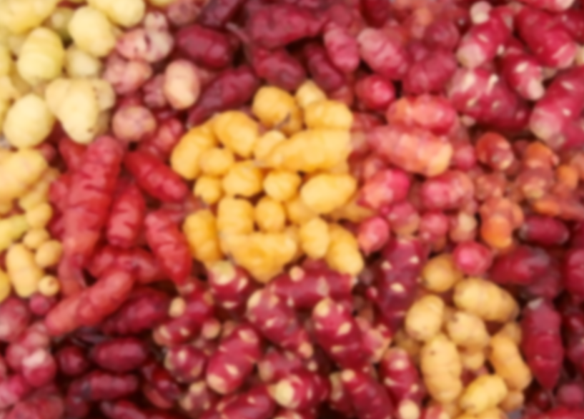
Potatoes? Tuberculosis? Cancer? not quite...
Tuberous sclerosis complex
and the TSC2 gene
Rachel Yan

Slide 2
So what is TSC?

Slide 3
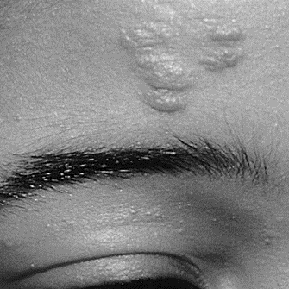
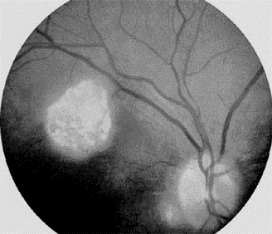
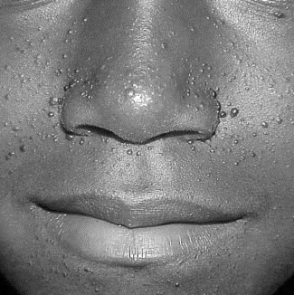
How does TSC manifest?

Slide 4
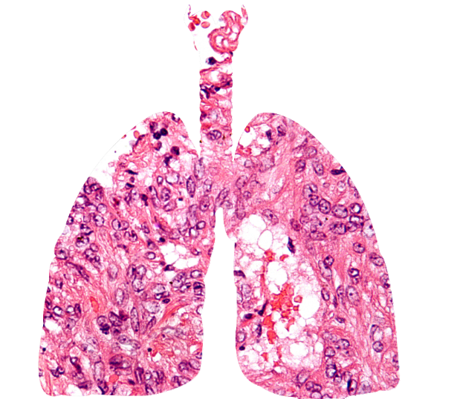
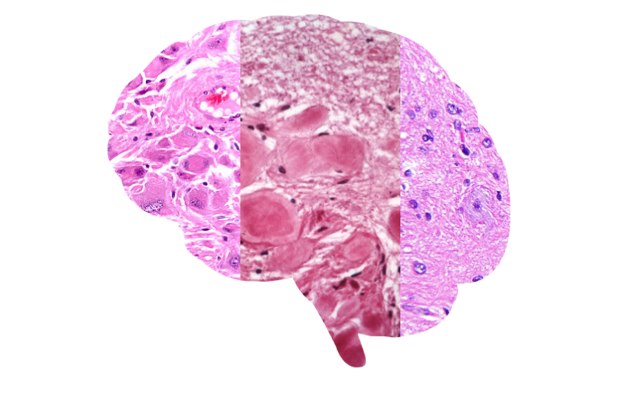
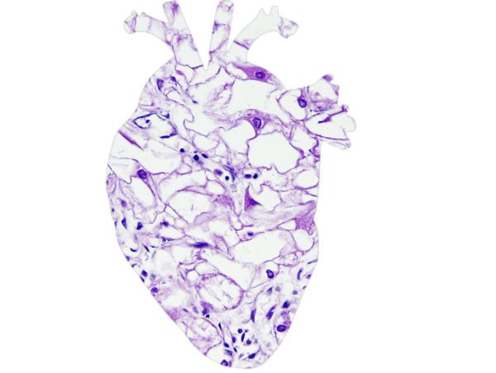
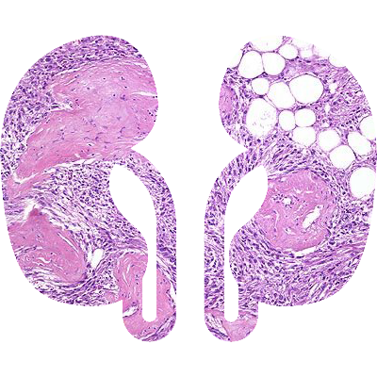
Is TSC in multiple tissues?
How does TSC manifest?
Notes:
Definite: 2 or 1 + 2
Probable: 1 + 1
Possible: 1 or 0 + 2

Slide 5
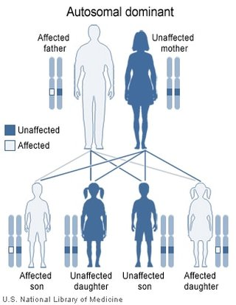
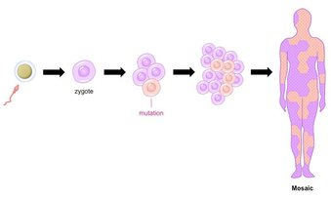
How do people get TSC?

Slide 6
How do people get TSC?

Slide 7
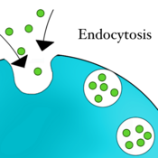
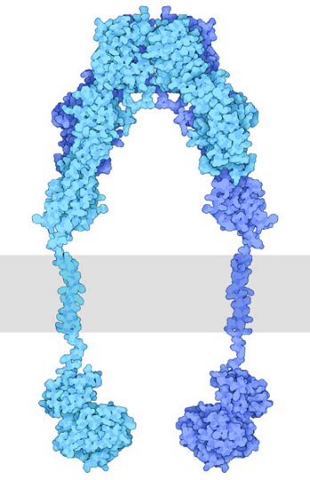
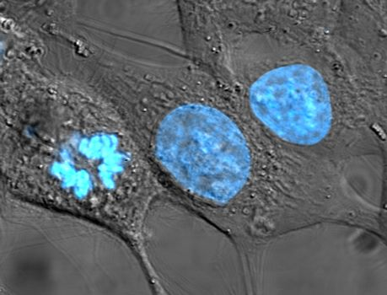
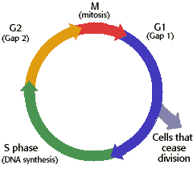
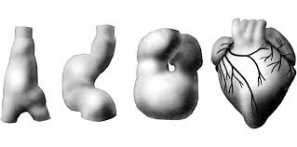
What does WT TSC2 protein do?
Notes:
1. https://upload.wikimedia.org/wikipedia/commons/6/6c/HeLa_cells_stained_with_Hoechst_33258.jpg
2. https://sophialearning.s3.amazonaws.com/packet_logos/20990/grid/endocytosis.png?1325212947
3. https://cdn.rcsb.org/pdb101/motm/images/182-InsulinReceptor_insulinreceptor.jpg
4. http://www.biology.arizona.edu/cell_bio/tutorials/cell_cycle/graphics/cellcycle.gif
5. https://embryology.med.unsw.edu.au/embryology/images/thumb/3/31/Stage10_neural_sm.jpg/300px-Stage10_neural_sm.jpg
6. https://encrypted-tbn0.gstatic.com/images?q=tbn:ANd9GcQ4pbANDaN_A0f8Pf8AidTrfMbei1LzYiHGxkwSjJgJ4tfy1Bhj

Slide 8
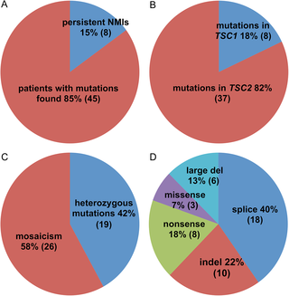
What is missing in our understanding of TSC?
http://dx.doi.org/10.1371/journal.pgen.1005637

Slide 9
Hypothesis
Previously unknown elements of TSC2 gene regulation and interaction networks result in TSC without knockout of the gene

Slide 10
How well-conserved is TSC2?
Human
DUF3384
tuberin
Rap-GAP
1807aa
Rat
DUF3384
tuberin
Rap-GAP
1809aa
Mouse
DUF3384
tuberin
Rap-GAP
1808aa
Zebrafish
DUF3384
tuberin
Rap-GAP
1818aa
Xenopus
DUF3384
tuberin
Rap-GAP
1808aa
D. melanogaster
DUF3384
tuberin
Rap-GAP
1847aa
C. elegan
Rap-GAP
811aa
E. coli
79aa
Bonobo
DUF3384
tuberin
Rap-GAP
1807aa
Naked mole rat
DUF3384
tuberin
Rap-GAP
1810aa

Slide 11
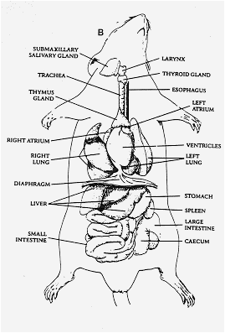
What model organism should be used?
Notes:
https://anatomysullivan.files.wordpress.com/2009/03/rat-outline.png?w=468

Slide 12
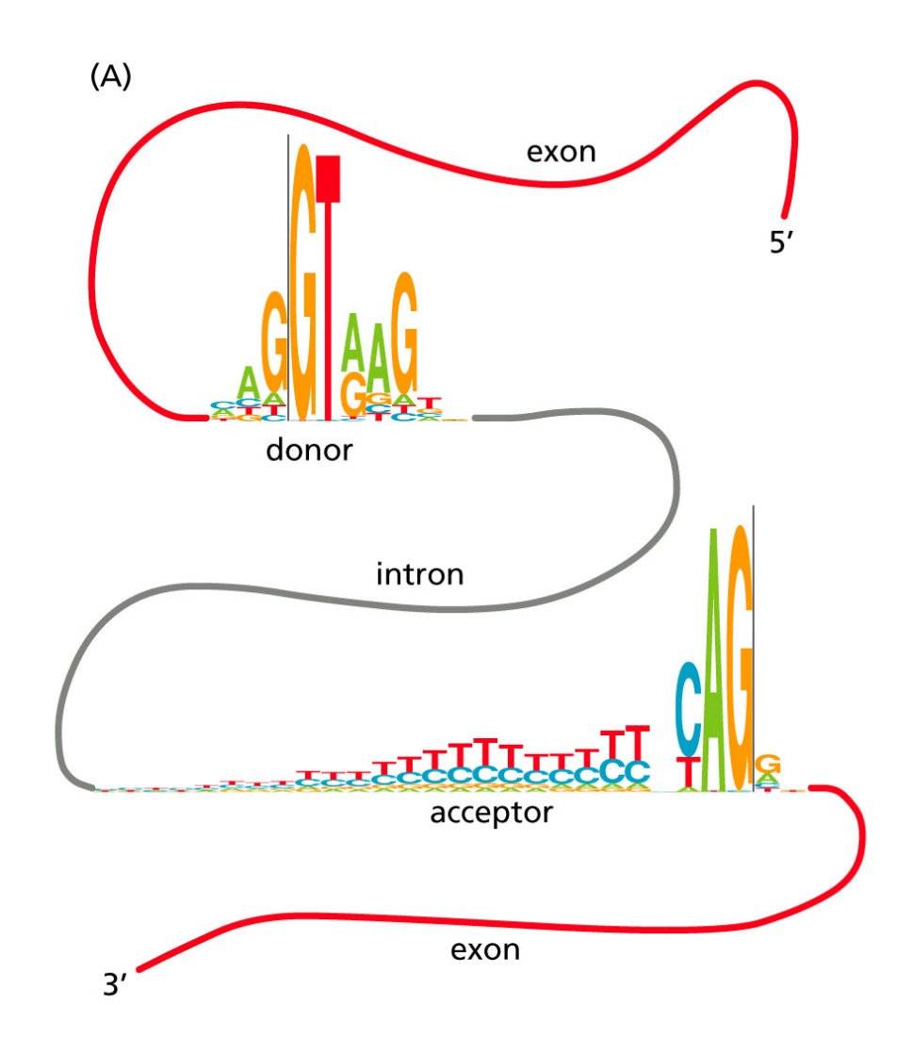
Aim 1: Genome Are there conserved sequences in intronic TSC2 that may be important for transcription?
?
?
?
?
?
BLAST
Phylogeny
CRISPR/Cas9
http://dx.doi.org/10.1371/journal.pgen.1005637
Notes:
http://www.scielo.br/img/revistas/gmb/2017nahead//1415-4757-gmb-1678-4685-GMB-2015-0321-gf01.jpg
Rationale: Patients with no mutation identified may have intronic variants that affect TSC2 transcription.
Hypothesis: I hypothesize that mutations in conserved regions will identify important intronic sequences for TSC2 transcription.

Slide 13
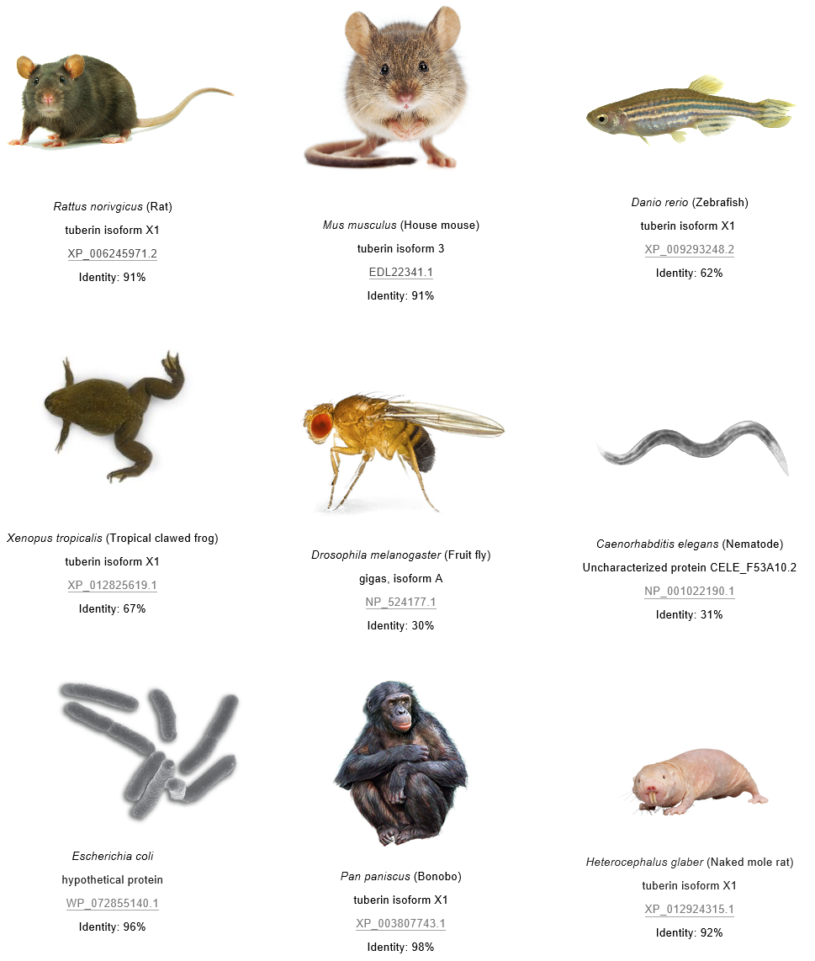
Aim 1: Identify conserved sequences in intronic TSC2 that may be important for transcription
BLAST
CRISPR/Cas9
MSA
Notes:
Approach: I will use BLAST to identify TSC2 homologs in humans and homologous species. I will then build phylogenetic trees using neighbor-joining and the BLOSUM62 matrix. I will identify highly conserved intronic sequences over evolutionary time, then use CRISPR/Cas9 to create mice with deletions in these sequences. I will then screen for any pathogenic effects.How?

Slide 14
Aim 1: Identify conserved sequences in intronic TSC2 that may be important for transcription
BLAST
MSA
CRISPR/Cas9
Notes:
Change to actual data if possible
https://www.researchgate.net/profile/Rauri_Bowie/publication/293917809/figure/fig2/AS:330997557153793@1455927375139/Figure-S2-Multiple-sequence-alignment-showing-the-homoplastic-microinversions-in-CLTC.png

Slide 15
Aim 1: Identify conserved sequences in intronic TSC2 that may be important for transcription
gRNA 1
gRNA 2
Exon A
Intron
Exon B
(conserved)
NHEJ
Exon A
Intron
Exon B
RNA splicing
Exon A
Exon B
?
BLAST
MSA
CRISPR/Cas9

Slide 16
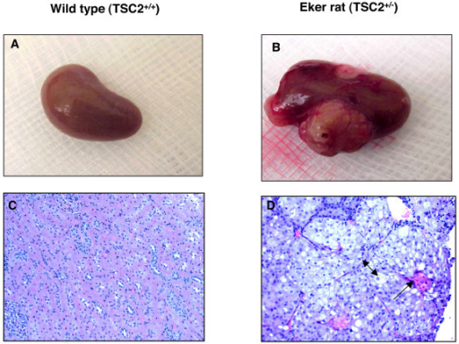
Aim 2: Transcriptome Are there different transcript levels in the knockouts we created?
RNA-seq
Gene Ontology
CRISPR/Cas9
http://dx.doi.org/10.1371/journal.pgen.1005637
Notes:
https://openi.nlm.nih.gov/imgs/512/92/2265742/PMC2265742_1476-4598-7-10-3.png

Slide 17
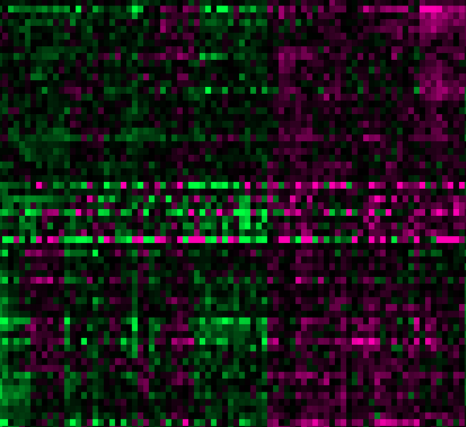
Aim 2: Compare transcript levels in WT and knockout rats
RNA-seq
Gene Ontology
CRISPR/Cas9

Slide 18
Aim 2: Compare transcript levels in WT and knockout rats
RNA-seq
Gene Ontology
CRISPR/Cas9

Slide 19
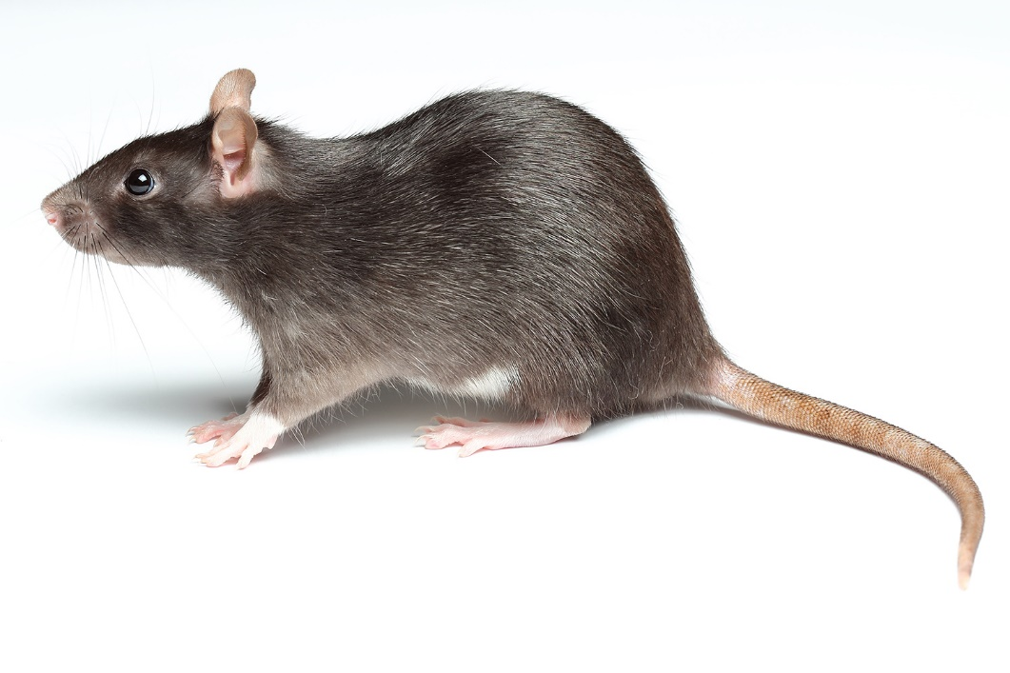
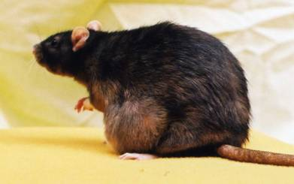
Aim 2: Compare transcript levels in WT and knockout rats
New CRISPR/Cas9 knockouts
RNA-seq
Gene Ontology
CRISPR/Cas9
Notes:
http://www.domyownpestcontrol.com/images/content/rat.jpg
http://www.ratfanclub.org/tumors_files/image006.jpg

Slide 20
References
[1] Orlova, K. A., Crino, P. B. (2010). The tuberous sclerosis complex. Annals of the New York Academy of Sciences, 1184, 87–105. http://doi.org/10.1111/j.1749-6632.2009.05117.x [2] Davis, P. E., Peters, J. M., Krueger, D. A., & Sahin, M. (2015). Tuberous Sclerosis: A New Frontier in Targeted Treatment of Autism. Neurotherapeutics, 12(3), 572–583. http://doi.org/10.1007/s13311-015-0359-5 [3] Chu-Shore, C. J., Major, P., Camposano, S., Muzykewicz, D. and Thiele, E. A. (2010). The natural history of epilepsy in tuberous sclerosis complex. Epilepsia, 51, 1236–1241. http://doi.org/10.1111/j.1528-1167.2009.02474.x [4] Yang, P., Cornejo, K. M., Sadow, P. M., Cheng, L., Wang, M., Xiao, Y., … Wu, C.-L. (2014). Renal Cell Carcinoma in Tuberous Sclerosis Complex. The American Journal of Surgical Pathology, 38(7), 895–909. http://doi.org/10.1097/PAS.0000000000000237 [5] Inoki, K., Corradetti, M. N., Guan, K. (2005). Dysregulation of the TSC-mTOR pathway in human disease. Nature Genetics 37, 19-24. http://doi.org/10.1038/ng1494 [6] Roach, E.S., Gomez, Manuel, R., Northup, H. (1998). Tuberous Sclerosis Complex Consensus Conference: Revised Clinical Diagnostic Criteria. Journal of Child Neurology, 13(12) 624-628. http://doi.org/10.1177/088307389801301206 [7] Kwiatkowski, D. J., Palmer, M. R., Jozwiak, S., Bissler, J., et al. (2015). Response to everolimus is seen in TSC-associated SEGAs and angiomyolipomas independent of mutation type and site in TSC1 and TSC2. European Journal of Human Genetics 23, 1665–1672. http://doi.org/10.1038/ejhg.2015.47 [8] Qin, W., Kozlowski, P., Taillon, B.E. et al. (2010). Ultra deep sequencing detects a low rate of mosaic mutations in tuberous sclerosis complex. Human Genetics, 127(5), 573-582. http://doi.org/10.1007/s00439-010-0801-z [9] Tyburczy M. E., Dies K. A., Glass J., Camposano S., Chekaluk Y., et al. (2015) Mosaic and Intronic Mutations in TSC1/TSC2 Explain the Majority of TSC Patients with No Mutation Identified by Conventional Testing. PLOS Genetics 11(11): e1005637. http://doi.org/10.1371/journal.pgen.1005637 [10] Giannikou K., Malinowska I. A., Pugh T. J., Yan R., Tseng Y. Y., et al. (2016). Whole Exome Sequencing Identifies TSC1/TSC2 Biallelic Loss as the Primary and Sufficient Driver Event for Renal Angiomyolipoma Development. PLOS Genetics 12(8): e1006242. http://doi.org/0.1371/journal.pgen.1006242 [11] Crino, P. B., Aronica, E., Baltuch, G., & Nathanson, K. L. (2010). Biallelic TSC gene inactivation in tuberous sclerosis complex. Neurology, 74(21), 1716–1723. http://doi.org/10.1212/WNL.0b013e3181e04325 [12] Foulkes, W. D., & Real, F. X. (2013). Many mosaic mutations. Current Oncology, 20(2), 85–87. http://doi.org/10.3747/co.20.1449
[13] Tee AR, Manning BD, Roux PP, Cantley LC, Blenis J (2003) Tuberous sclerosis complex gene products, tuberin and hamartin, control mTOR signaling by acting as a GTPase-activating protein complex toward Rheb. Curr Biol 13(15), 1259–68. http://doi.org/10.1016/S0960-9822(03)00506-2.
[14] Giannikou K, Malinowska IA, Pugh TJ, Yan R, Tseng Y-Y, Oh C, et al. (2016) Whole Exome Sequencing Identifies TSC1/TSC2 Biallelic Loss as the Primary and Sufficient Driver Event for Renal Angiomyolipoma Development. PLoS Genet 12(8): e1006242. http://doi.org/10.1371/journal.pgen.1006242 [15 Tyburczy ME, Dies KA, Glass J, Camposano S, Chekaluk Y, Thorner AR, et al. (2015) Mosaic and Intronic Mutations in TSC1/TSC2 Explain the Majority of TSC Patients with No Mutation Identified by Conventional Testing. PLoS Genet 11(11): e1005637. http://doi.org/10.1371/journal.pgen.1005637

Slide 21
Image References
Video References
​Novartis, https://www.youtube.com/watch?v=0WOAv3O_Vb8&t=25s
Image References
Header/Footer: https://www.cultivariable.com/buyers-guide-for-andean-roots-and-tubers/
Dr. House: http://www.housemd-guide.com/timeline-ep.php
Mosaic: https://www.pinterest.com/pin/292100725800999804/
Fig 1:http://www.daviddarling.info/images/autosomal_dominant.jpg
Fig 2: http://ib.bioninja.com.au/standard-level/topic-3-genetics/34-inheritance/mosaicism.html
Fig 3: https://en.wikipedia.org/wiki/Everolimus
Forehead plaque: http://www.medicinenet.com/image-collection/tuberous_sclerosis_fibrous_plaque_picture/picture.htm
Fig 4: http://www.lsi.umich.edu/inoki-lab/inoki-lab-research, [12]
FacialAngiofibroma: http://www.wikidoc.org/index.php/Tuberous_sclerosis_physical_examination
Retinal Nodular hamartoma: http://flylib.com/books/en/3.283.1.13/1/
Cortical tuber: http://frontalcortex.com/?page=oll&topic=24&qid=479
SEN: http://neuropathology-web.org/chapter7/chapter7aTumorsgeneral.html
SEGA: ​http://www.webpathology.com/image.asp?case=742&n=2
​Cardiac Rhabdomyoma: ​http://neuropathology-web.org/chapter7/images7/7-ts-heartmicro.jpg
Hypomelanotic macules:
Shagreen patch:
LAM: https://upload.wikimedia.org/wikipedia/commons/4/44/Lymphangioleiomyomatosis_-_very_high_mag.jpg
Cardiac rhabdomyoma:
​Renal angiomyolipoma: http://www.webpathology.com/image.asp?case=71&n=5
Nontraumatic ungual/periungual fibroma: ​

